Slide 1


Hiil AI
Members
Abdulaahi sharif hassan (leader)
Sumaya Mohamed dhaqane
Abuukar ali abdalla
Zakariye mohamed dirie
Hassan abdulaahi Mohamed
Ahmed jamal abahaji
Zakariye hassan abdi
Abdurahmaan mohamuud
Adam abdi adam

Slide 2
Waa maxay Hiil AI ?
Waa Ai cawinaya ardayda fresh ka ah ee so dhamenaya school kuwaaso u bahan
in laga caawiyo Kulliyada ku haboon ee baran karaan ayago u shegaya AI ka
madada school ka ay ku fiicnayeen.

Slide 3
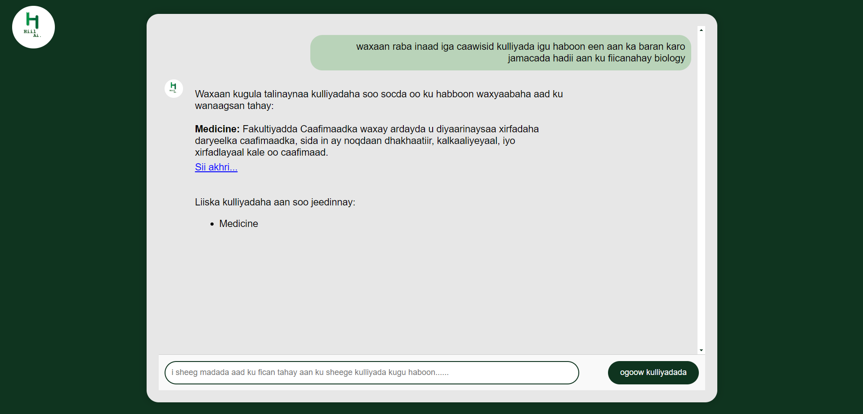
Marka uu ardayga u sheego madada u ku fican yahay.

Slide 4
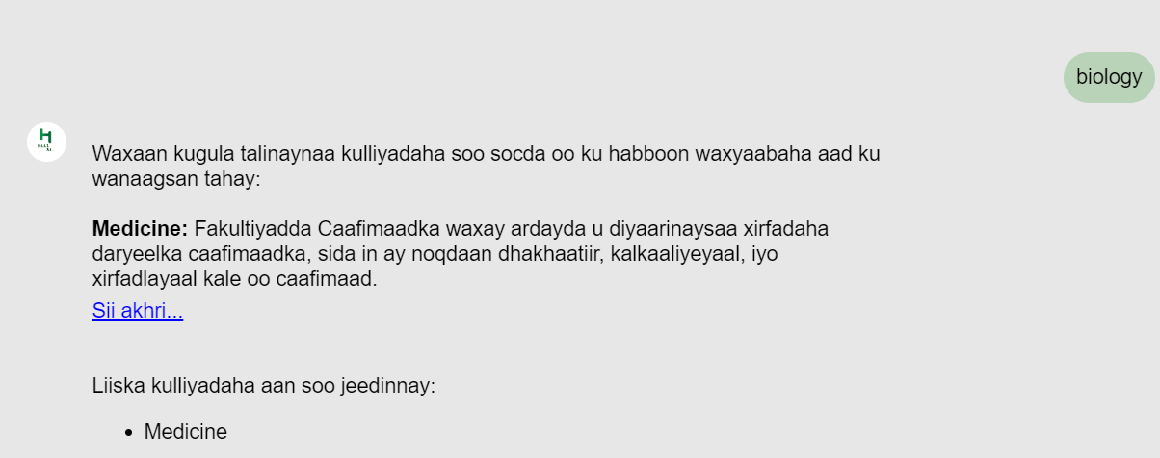
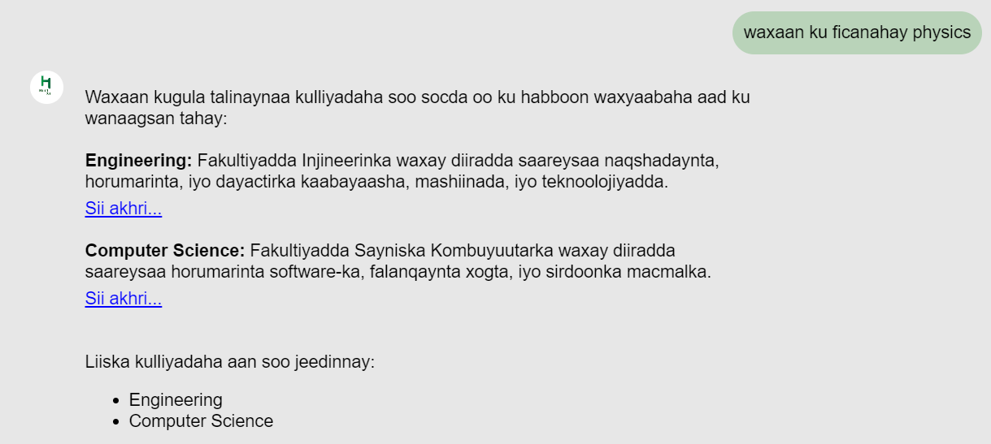
Laba qaab wa loo weydiin karaa.

Slide 5
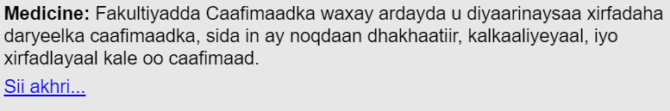
Link ama tixraac
Hill AI marka uu dhameeyo qoraalka ardayga waxa uu sinaya link kaas oo kasii tixraaci karo faculties ka kala duwan ee jamacadaha ay bixiyaan.
Wuxuna ardayga ku dhufan donaa link ka ah sii akhri

Slide 6
Languages , Framework and tools
Python flask 90%
Javascript
HTML,CSS
Json file
Vs code
Open ai

Slide 7
THANK YOU

